Slide 1

PREDICTING Pitchfork REVIEWS
Analyzing critical success in the music industry vis-à-vis classifying Pitchfork’s Best New Music selections

Slide 2
Methodology

Slide 3

Methodology
GOAL:
analyze a music reviews to gain key insights on what determines critical success on a major, influential platform
PROCESS:
use a gradient boosting decision tree algorithm (XGBoost) to predict whether or not an album Pitchfork-reviewed album will be categorized as “Best New Music”

Slide 4



Methodology
All data procured from the following sources:
18,393 album reviews from 1999 to 2017 from Kaggle
Best New Music classification, genre, review publication date, record label affiliation
Queried SQLite Database with SQLite3 module
1,466,083 records of artist-level data from Million Song Dataset
Unique listeners and total plays per artist
CSV
166,589 records of track-level data from the Spotify API
Sonic features (key, tempo, danceability, etc.)
Queried directly from API with Spotipy module

Slide 5
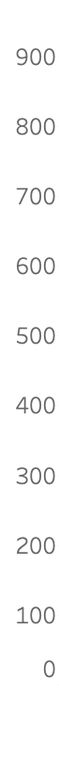
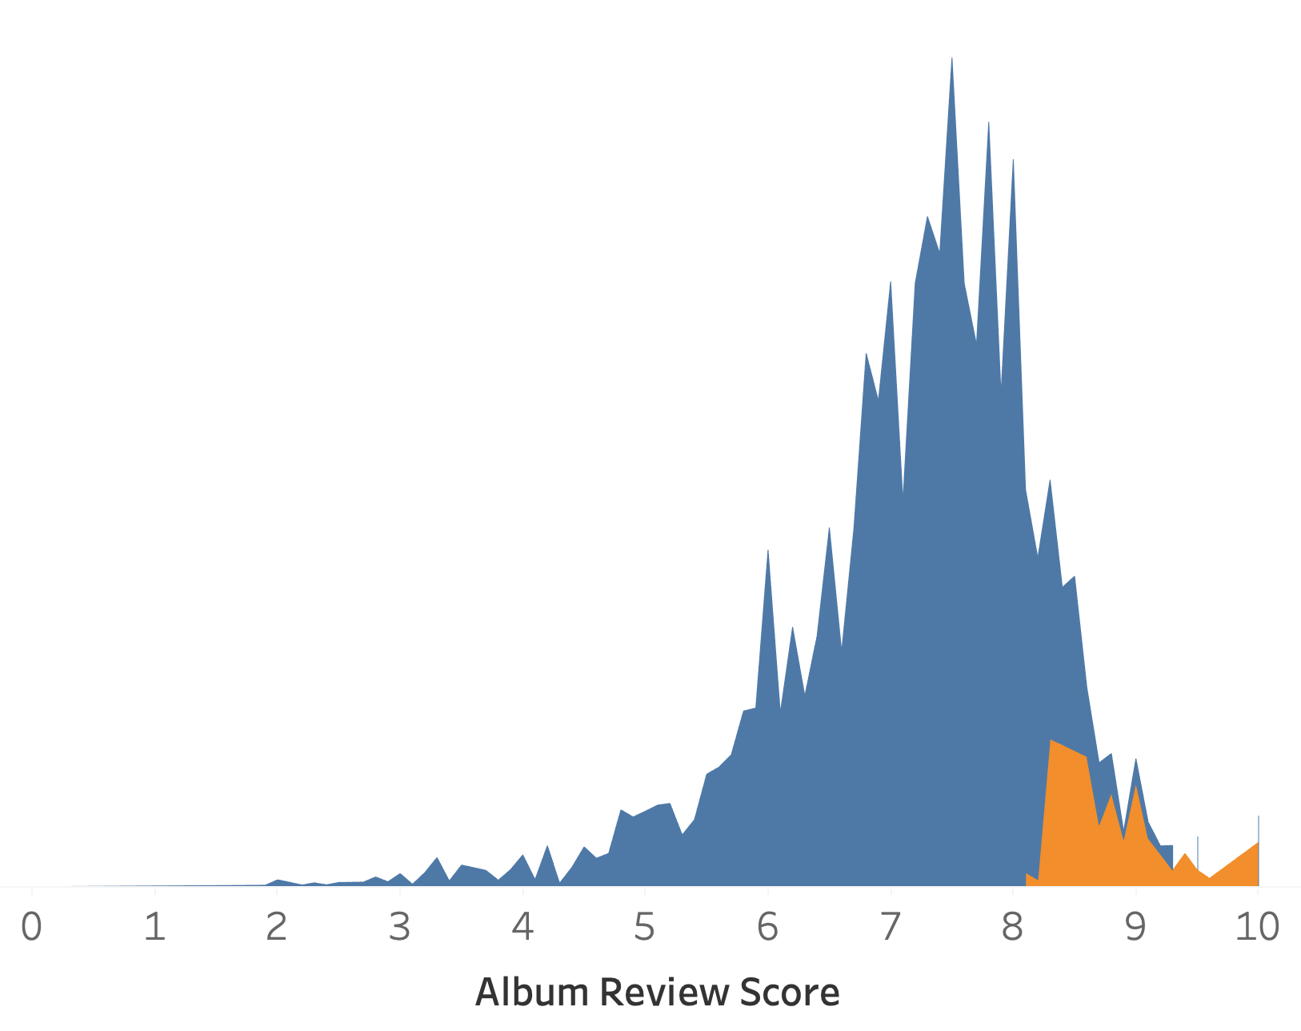
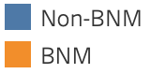
Best New Music Distribution
Challenges:
Target variable underrepresented (15:1)
Resampled
Adjusted decision threshold
Can’t use review score as a feature
Frequency

Slide 6
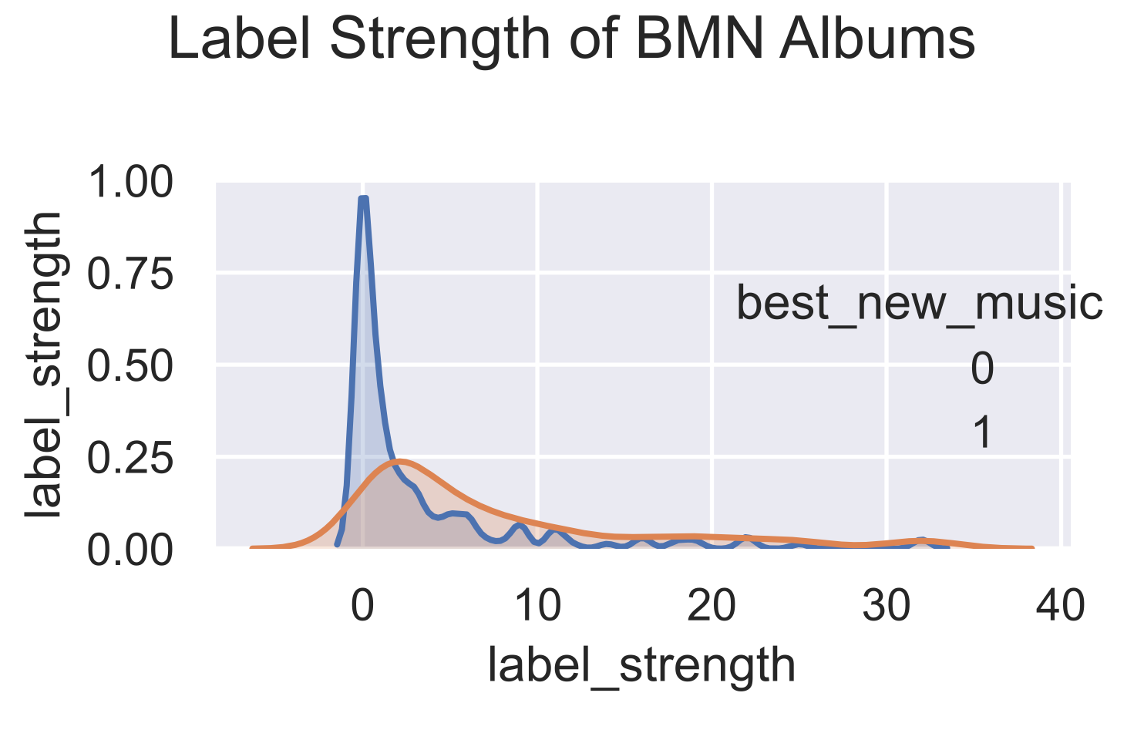
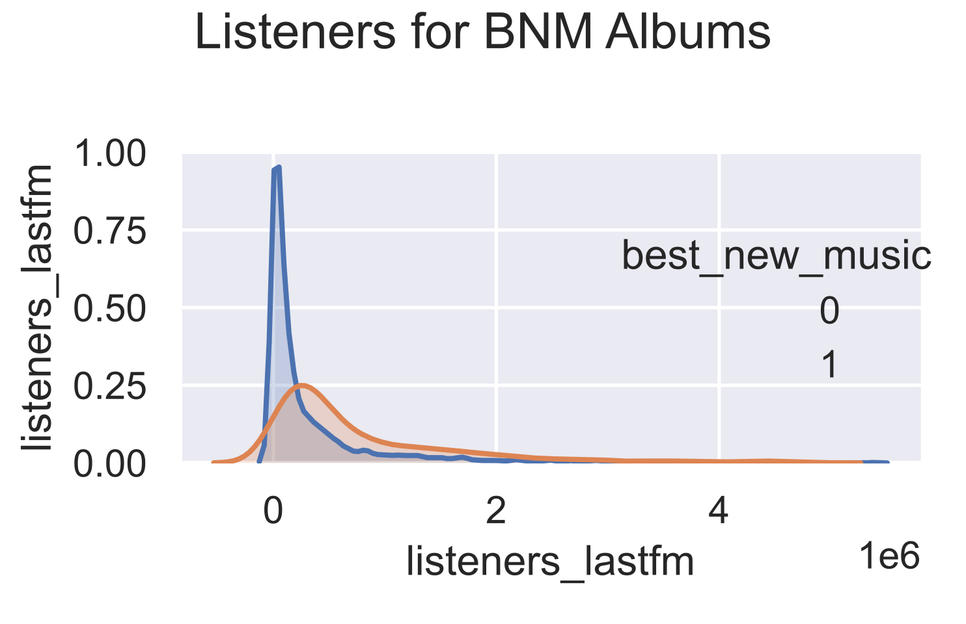
Key Features of the Model
A/B tested many feature combinations using F1 and ROC AUC to determine which were most effective
Best signal from:
Unique listeners
Total plays
“Label Strength”
Other features provided moderate class separation at best

Slide 7
RESULTS

Slide 8
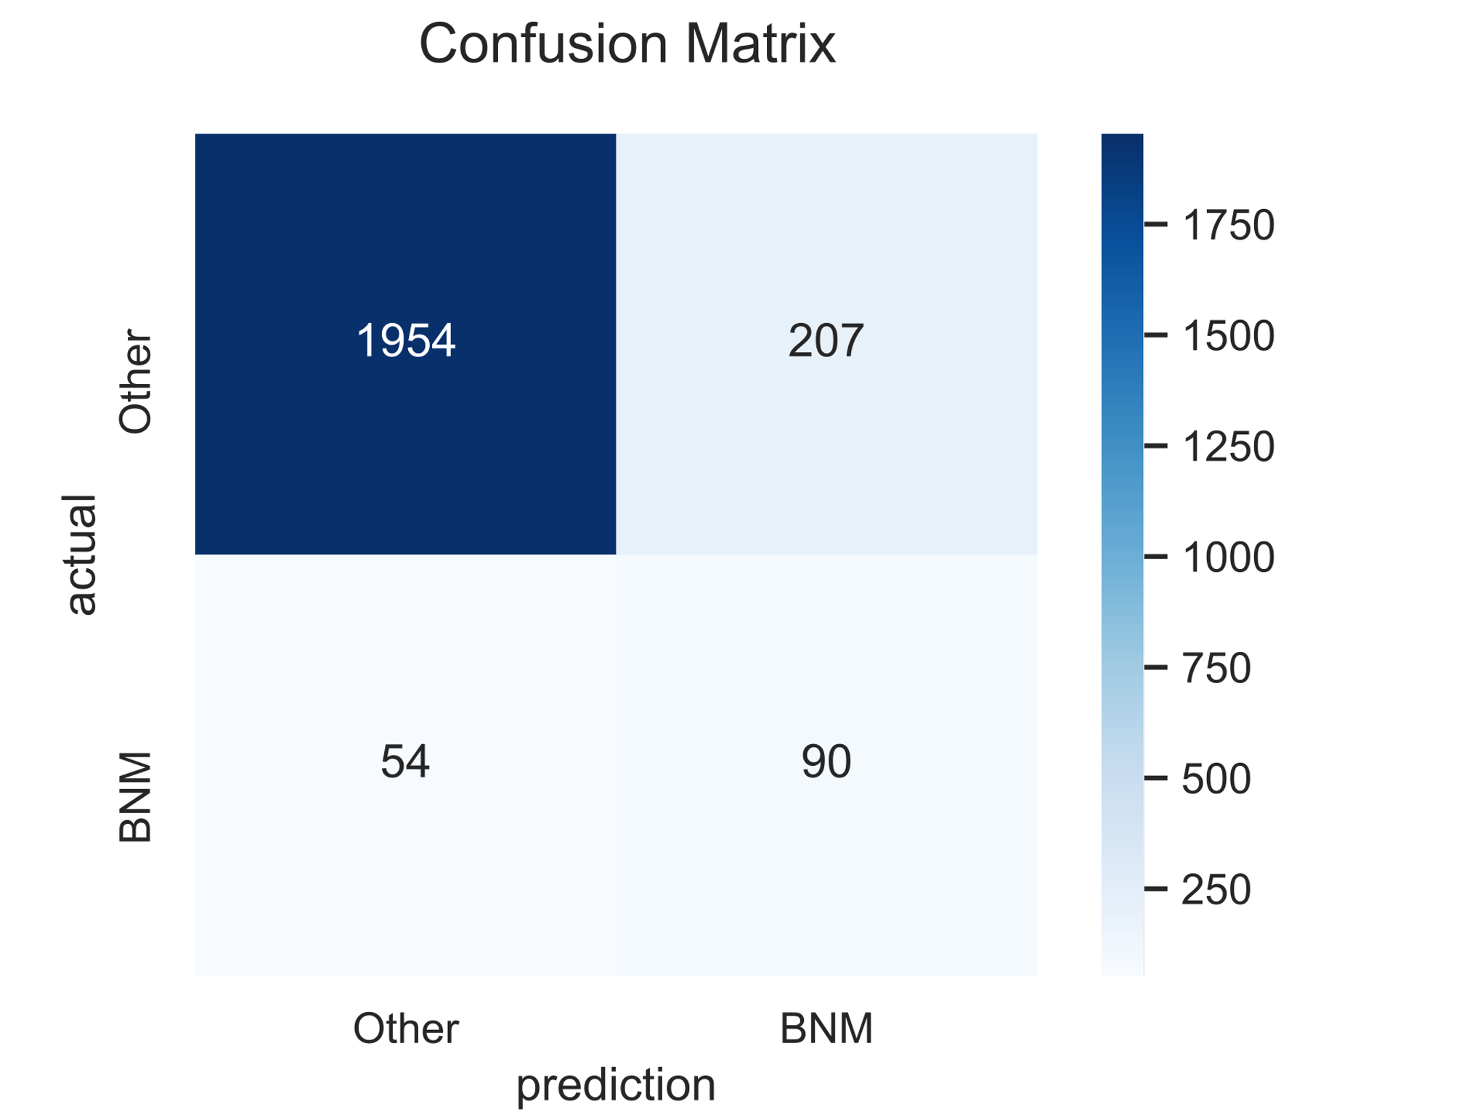
Classification Predictions
Results:
0.887 accuracy
F1 = 0.408
BNM Precision = 0.303
BNM Recall = 0.625
ROC AUC = 0.765
Analysis:
Class imbalance means that high accuracy is deceptive
Preponderance of false positives
Art and criticism are subjective, difficult problem to classify

Slide 9
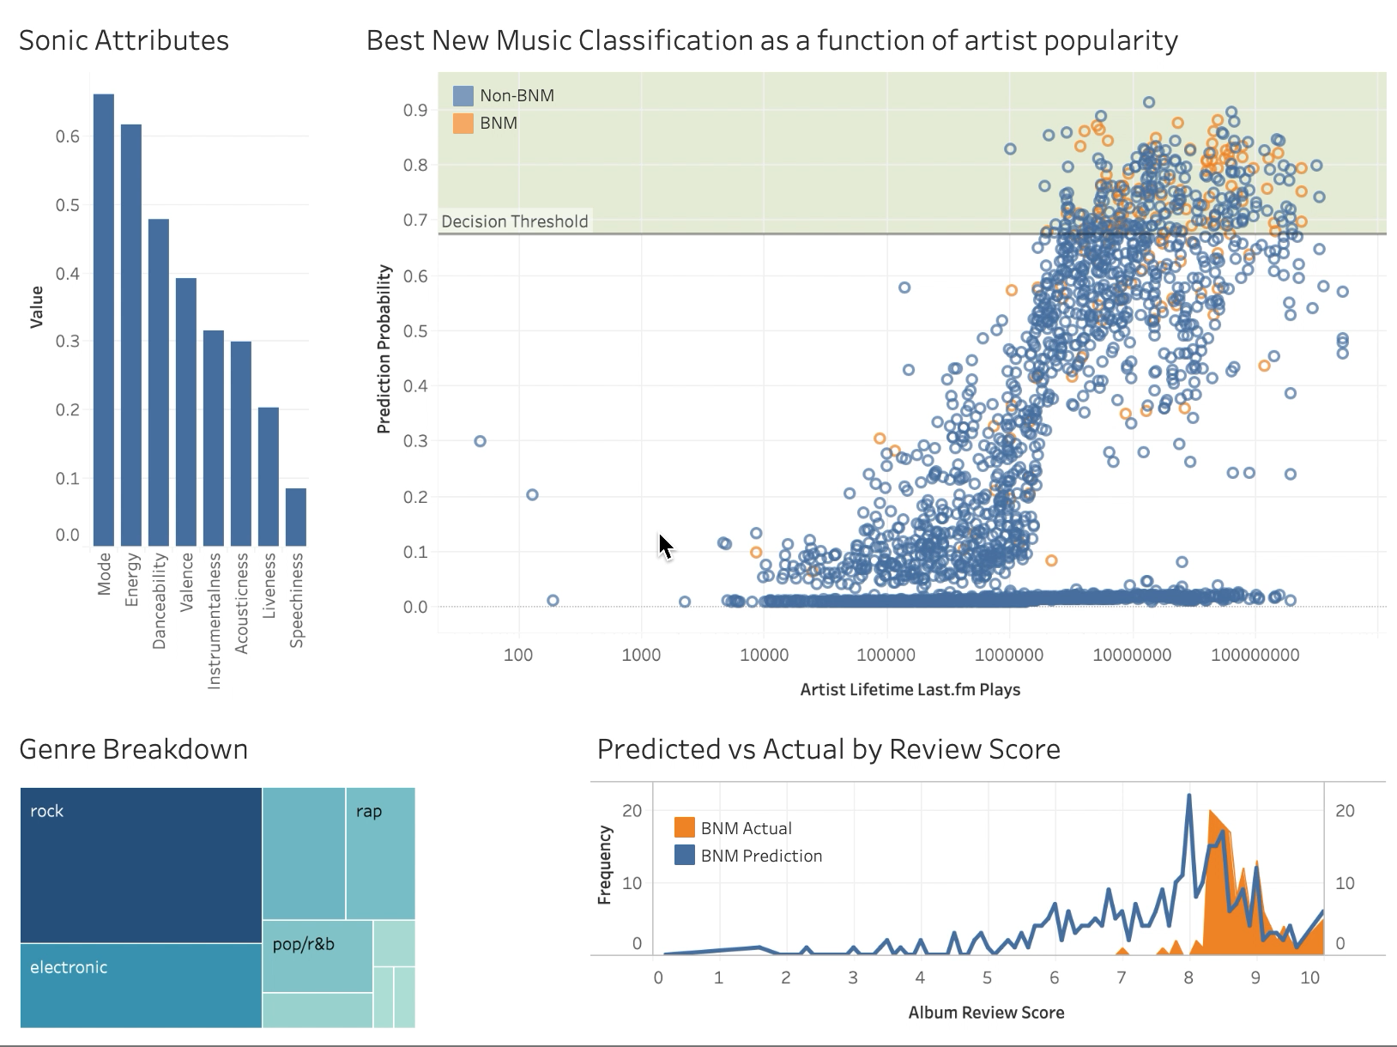
Dashboard
link

Slide 10
CONCLUSION

Slide 11
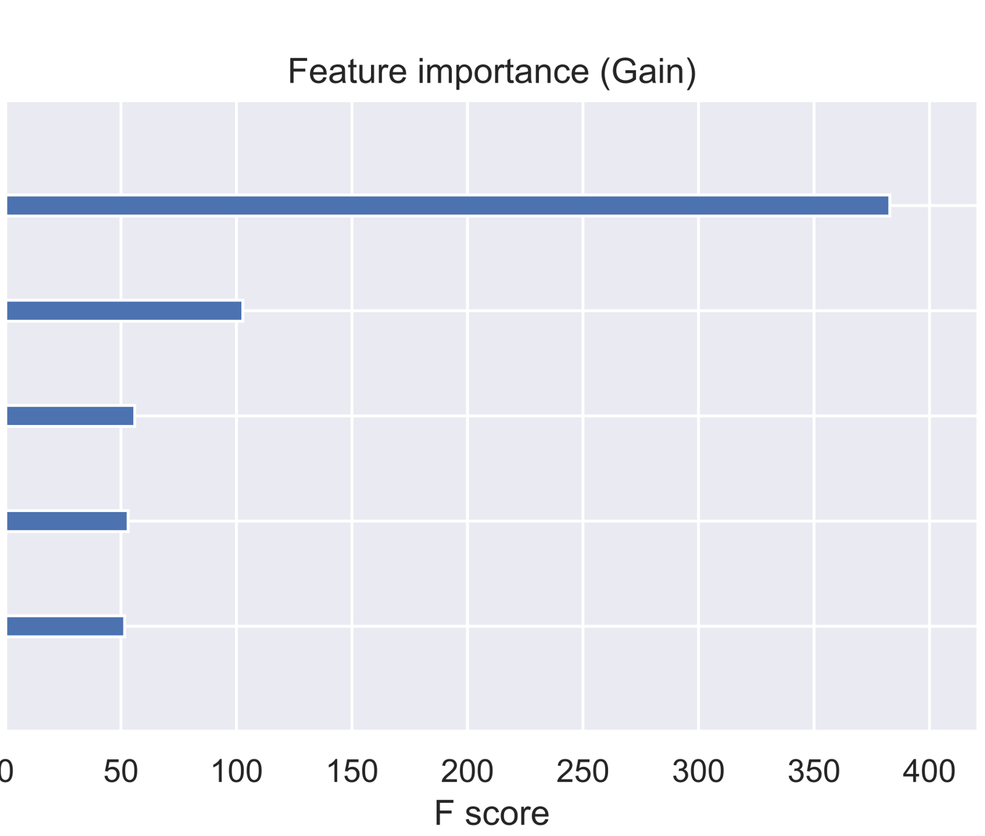
Key Takeaways
You can judge an album by its label.
Affiliation with more popular labels matters to reviewers
Clout carries serious weight.
Albums by artists with many more lifetime listens more likely to receive praise
Reviews are subjective
Sonic attributes don’t have a significant impact
Label Strength
Total artist plays
Review Delay
Genre: Other
Total artist listeners

Slide 12
Next Steps
Improve emerging artist predictions
Incorporate more data
Enhance model precision

Slide 13
Appendix

Slide 14
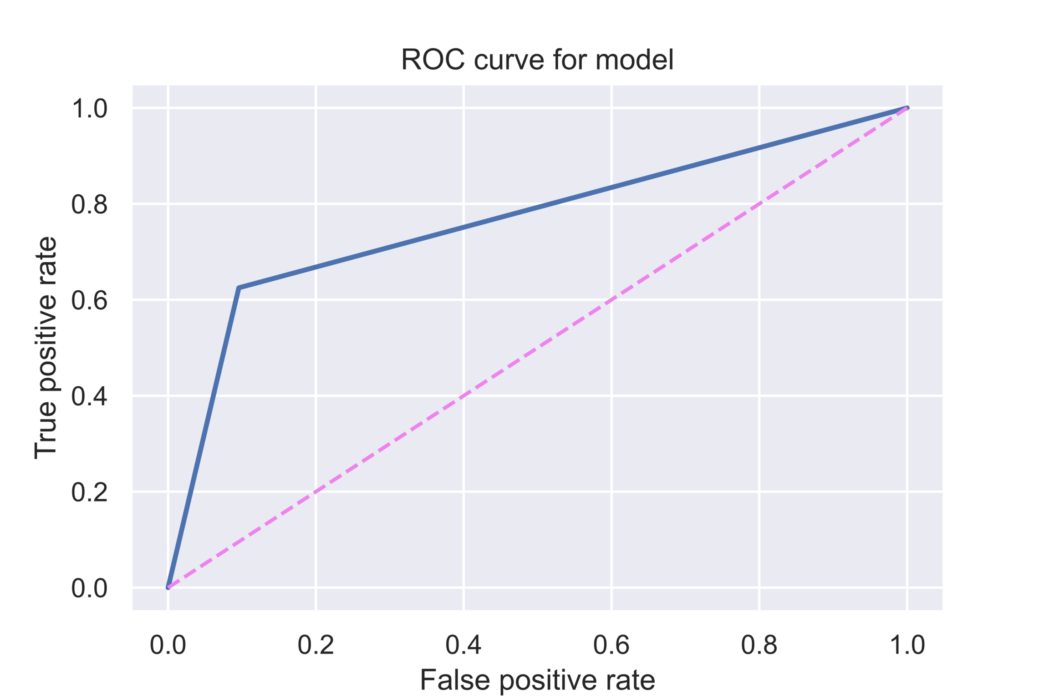
ROC Curve

Slide 15
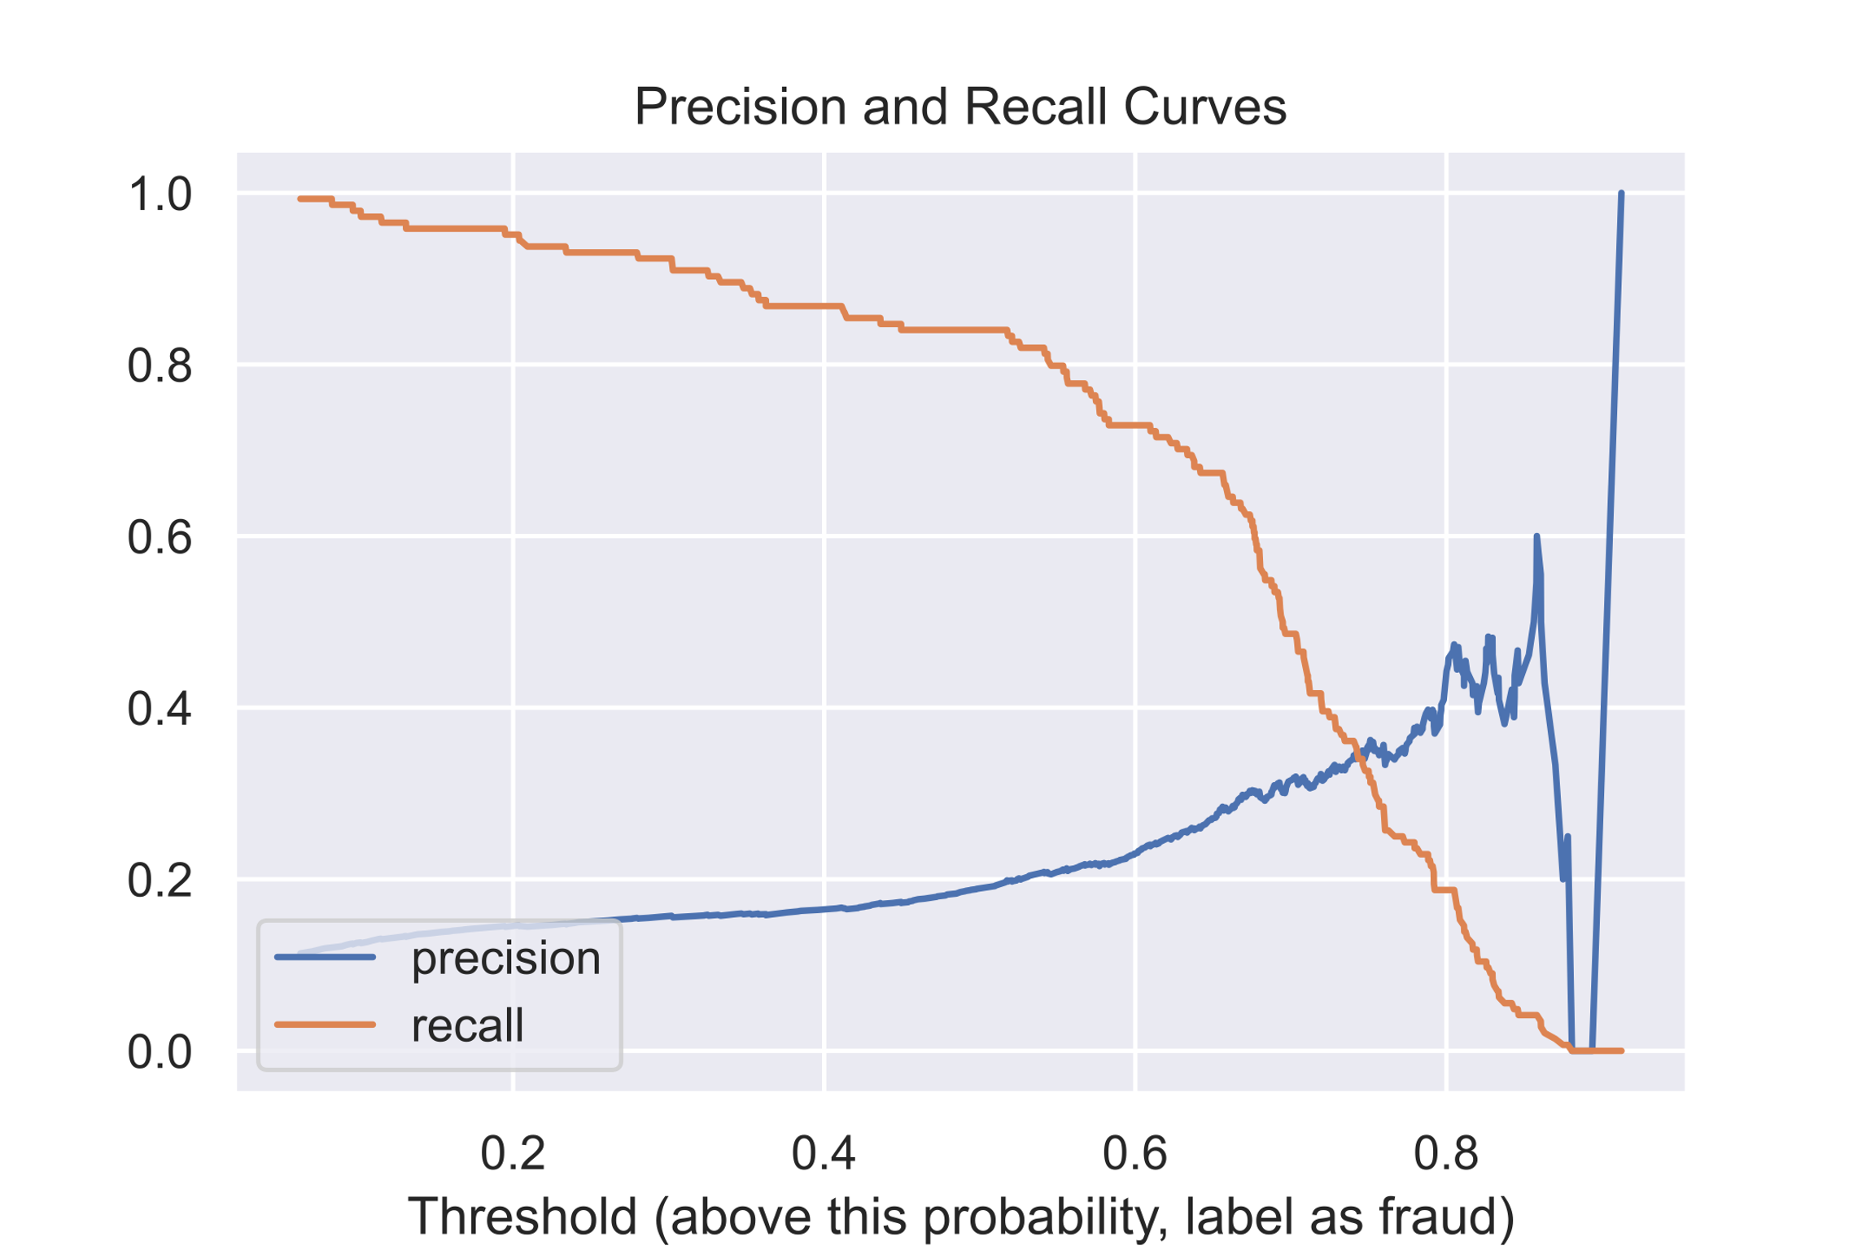
Precision and Recall

Slide 16
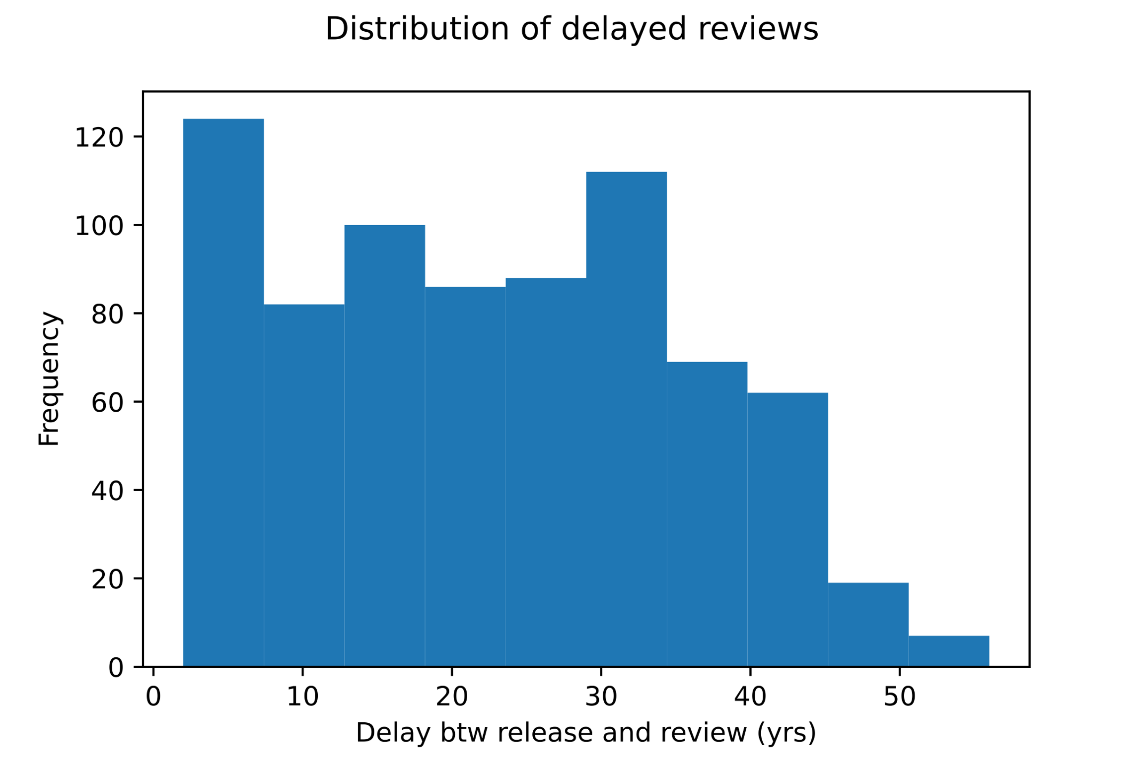
Review Publication Delay
Many albums were reviewed decades after their release date.

Slide 17
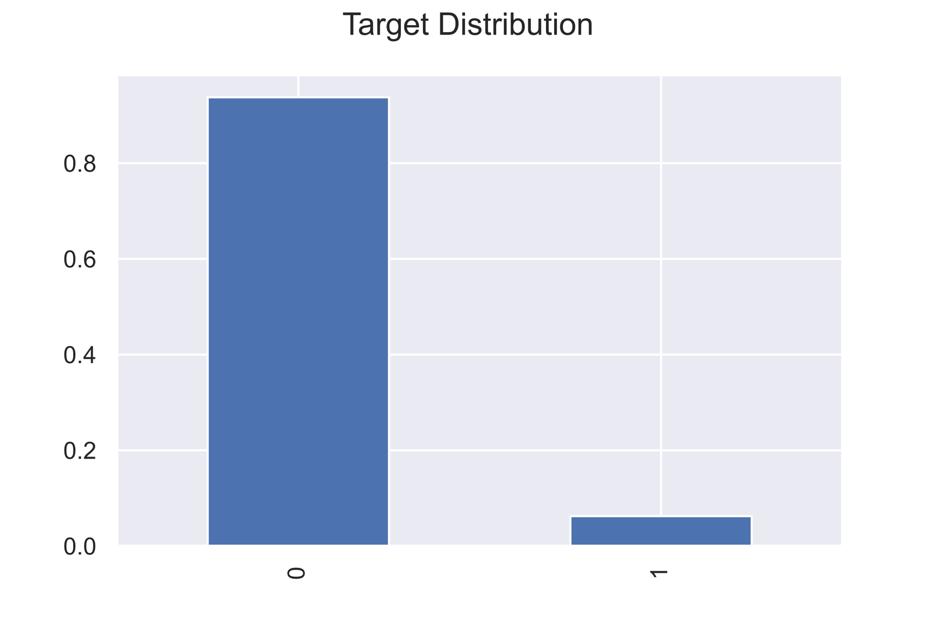
Class Imbalance
The minority class (BNM albums) were far fewer in quantity than the majority class
0: Non-BNM
1: BNM

Slide 18
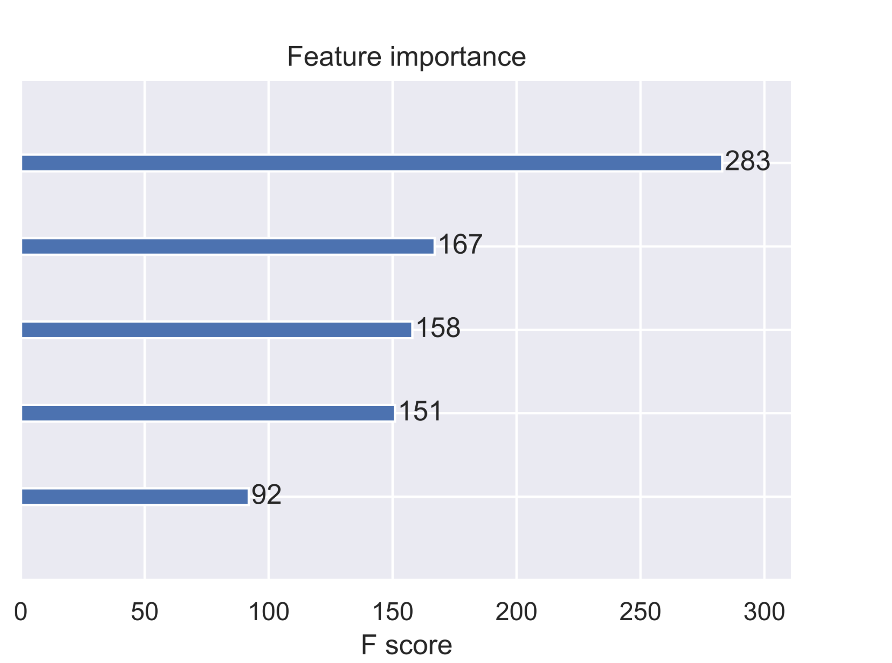
Feature Importance: Weight
Total artist plays
Total artist listeners
Track ‘speechiness’
Label strength
Track length variation

